Slide 1

INTRODUCTION
The following data analysis evaluates 15 holiday destinations for a travel website to establish the most popular, and which should be excluded in future recommendations.
The study uses previous holidaymaker feedback data and average hotel star ratings for each location. The number of all-inclusive hotels within each destination is also examined against destination scores to establish if there is any correlation.
Python and Pandas library were utilised to produce this insight.
Yenny Aplin

Slide 2

1. STATE NUMBER OF ROWS AND COLUMNS IN THE FILE
OUTPUT
Holiday.csv
CODE

Slide 3
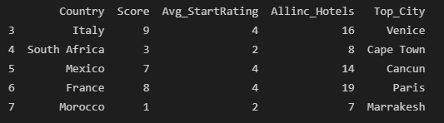

2a. PRINT ROW 3-8 ( USING ILOC)
OUTPUT
CODE

Slide 4
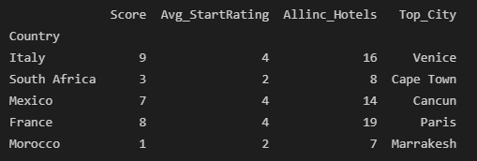
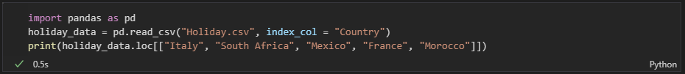
2a. PRINT ROW 3-8 ( USING LOC)
OUTPUT
CODE

Slide 5


3. FIND THE MEAN NUMBER OF ALL-INCLUSIVE HOTELS ACROSS ALL DESTINATIONS
OUTPUT
CODE

Slide 6

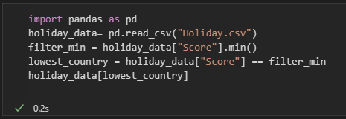
4. FIND THE LOWEST SCORING DESTINATION
OUTPUT
CODE

Slide 7


5. FIND THE HIGHEST SCORING DESTINATION
OUTPUT
CODE

Slide 8
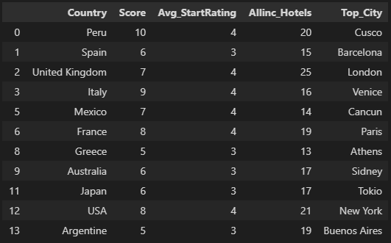

6. FIND ALL THE DESTINATIONS WHERE THERE ARE MORE THAN 9 ALL-INCLUSIVE HOTELS
OUTPUT
CODE

Slide 9


7. FILTER THE DATA BY SCORE ABOVE 8
OUTPUT
CODE

Slide 10

8. FILTER THE DATA SCORE BELOW 2 (TO IDENTIFY DESTINATIONS TO BE REMOVED)
OUTPUT
CODE

Slide 11

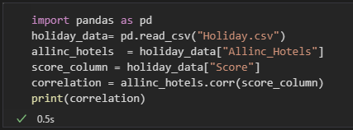
9. CORRELATION BETWEEN NUMBER OF ALL-INCLUSIVE HOTELS AND SCORE
OUTPUT
CODE

Slide 12
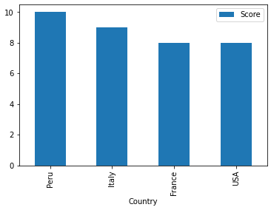

10. DESTINATION AND HIGHEST SCORES
OUTPUT
CODE

Slide 13




CONCLUSION
The mean number of all-inclusive hotels across all destinations was 14.9 with 11 destinations having more than 9 hotels
The lowest scoring destination was Morocco and the highest scoring destination was Peru
There is a moderate to good correlation (0.72 coefficient) between the destination score and number of all-inclusive hotels
The destination that should be excluded from future considerations is Morocco with a score below 2
Peru, Italy, France and USA had the highest destination scores (over 7), and are therefore recommended holiday locations

